Slide 1



Search customizations with app model

Slide 2
Agenda
Reusable IP and content from the particular scenario
Building blocks for UX Components
Display Templates and Result Types
Using search API in the apps and in content
Personalized search results
Search configuration and customizations
Search center customizations
Search based site directory

Slide 3
Overview
Search in SharePoint 2010
 | SharePoint Search | FAST Search
Focus | Enterprise search | Search application platform
Strengths | Ease of deployment, low TCO | Scale, Extensibility
Limitations | Limited extensibility | Complex deployment, maintenance
Products | SharePoint Foundation, SharePoint Server, Search Server | FAST Search for SharePoint, FAST Search for Internet Sites
Notes:
This a look back of our Search in SharePoint 2010.
In SharePoint 2010 we had two different Search engines, SharePoint Search and the FAST search Server.
SharePoint search was an easier deployment that focused on enterprise / portal searching.
Fast was more of a search platform meant more for large scale and extensibility. With extensibility and configuration also came some complexities.
Each platform had its pros and cons and often there was misunderstanding or misconceptions with the different platforms.

Slide 4

Search in SharePoint 2013
Single Extensible Platform
FAST Engine
SharePoint Crawler
Best of both!
Same Search Platform in both SharePoint and Exchange
Notes:
In 2013 we have 1 search engine and the idea was to take the best of each of the platforms in 2010 and build on top of that.
So for example we have the extensibility and relevancy of the FAST search engine, but more of the ease and familiarity of
configuration and management of the SharePoint Search engine.

Slide 5
Overview
Search Architecture
Enterprise Search
PARTNERS
CUSTOMER
My Tasks (Proj)
Content by Search
People Search
Topic Pages
Site Search
Video Search
EXTENSIBLE Search Platform
Notes:
This architecture slide covers some of the things you can do with search and how it is an extensible platform.
For example Enterprise, People, and Site search are all OOB things that people are familiar with
we have added items like Video Search to the out of box enterprise search capabilities.
But with this release we really started building common patterns in the search platform. One example of that is the Topic Pages and the Content by Search. These features greatly enhance our WCM capabilities and allow for search-driven sites in this version of SharePoint. If we are building an Internet Site that is based off of a product catalog users can select products by a category or see related products by using Content by Search and these topic pages. This is an experience we are all familiar with on public facing sites. Another area where this pattern might be useful is in Knowledge management sites.
Another pattern that is now handled by Search is the My Tasks is in Project. This was a common pattern in previous versions to build a search based application to over come the problem of tasks being assigned in multiple sites and users not being able to easy track these tasks. This is now being handled by the search platform. The My Tasks is a way to pull together Tasks and how them in the MySite.
An important part of this platform is we built the platform to make Search more easily extensible by Customers and Partners

Slide 6


Search architecture
HTTP
Enterprise Search Portal
File Shares
Web Service Callout
Query Engine
Query Pipeline
REST Service
Client Framework
Client-Side OM
SharePoint Sites and Portals
SharePoint
User Profiles
IMS Runtime
SharePoint topic and content pages
Crawl and Connectors
Content Pipeline
Indexing Engine
Exchange
SharePoint Sites and Portals
Lotus Notes
CTS Runtime
Analyzer
SharePoint Sites and Portals
Documentum
Custom
Custom non-SP Search Driven Apps
Notes:
Before going into details of extensibility it is important to understand the base components of Search and how it is architected.
Remember this platform was a combination of the FAST search engine and SharePoint.
In 2010 FAST really didn't crawl, it allowed push into index (Content API), while SharePoint crawled
In SharePoint 2013, the Content API is gone so if you are a FAST person and familiar with leveraging the Content API that is no longer available. We moved completely to a crawling paradigm as apposed to a content push paradigm that FAST previously had. In order to make sure the content is up to date the crawler now runs continuously. Continuous crawl focuses on a small number of things to be efficient. For example:
Continuous crawl is for the SharePoint index only so although we may have other sources outside of SharePoint, the continuous crawl is only focused on SharePoint content.
It makes use of the change log to pick up changes.
Continuous crawls run in parallel and do not wait for previous threads to complete so it updates quickly
Continuous crawls do not retry errors from previous crawls, so if a threads errors off on a piece of content that will not be retried and it will wait for the incremental crawl to pick it back up. What this means is we will still need Incremental crawls.
Security changes are included in the Continuous crawls
You don't really need a dedicated server for continuous, but you could. Depends on resource usage.
The Full and Incremental crawls still exist, and are still needed and be used for similarly how they were in 2010.
Full is still required under the same conditions as SharePoint 2010
(http://technet.microsoft.com/en-us/library/cc262794(office.12).aspx)
Incremental is required for security changes
Continuous for changes noticeable by end users
So you have this vision of continuous crawls running all the time, incremental crawls running periodically throughout a day and a fully crawl running maybe once a week. Those three types of crawls will keep the index updated and healthy.
We still have the concept of Managed Properties, much like previous versions we have crawled properties that get created by the crawler then we create managed properties to allow us to keyword query language searches against the index.
Managed properties are Administered at the Site Collection level.
In O365 you can do it on a tenant admin level.
Lets walk through the different components of the Search Architecture.
Architecture
Over on the left we are talking about the different Content Sources. In any Search architecture there are two things that need to happen. We need to be able to connect to the content Source and find any documents inside. Then the search needs to get the documents and be able to crawl the contents of the document itself to build up the index.
The way that we do that is through .Net assembly Connectors. And working through the document content is done through parsers.
In previous versions of SharePoint we used the connector Framework for Search.
The Parsers are new to the 2013 search architecture, but the concept is not. The Parser fills the role of the iFilter from previous versions of SharePoint. The iFilters have not gone away completely and in later parts of this section we will talk in more detail about the Parsers.
The next item in our architecture diagram is the content Pipeline. This is really just the processing of what the crawler finds to pass it along for building up the index. The CTS Runtime is called our here and it does the processing of the content, but it is no extensible with one exception, which is the Web Service call out.
The Web service Callout is a synchronous call to a Web Service for doing additional Content processing. We will talk more about the Web Service call out later, but basically it allows for a web service to send Managed Properties from an item to a Web Service that can then modify the content of the property and send it back into the pipeline. This gives you a way to perform specific tasks on items and modifying the properties before they get added to the index for that item.
The next stage is the Analyzer and Indexing Engine.
Analyzer - Process user behavior (click analysis). Supports things like recommendations based on behavior. There is an extensibility story for that.
Indexing Engine – Indexes content
We now have an index and on the right side of the diagram are the components used for querying the index.
There is the Query Engine that executes queries
The Query Pipeline is the functionality for processing queries.
IMS Runtime is the part that processes queries, but No real extensibility story.
Then the REST Service which Execute queries through REST in this diagram we are showing maybe a Custom non-SharePoint search application may be calling the REST Service or a Windows Phone calling the REST Service.
You can also see we have the Client Framework where we can Execute search queries through CSOM
much like how we may access items of a list through the CSOM model.

Slide 7
Display Templates and Result Types

Slide 8

UX made easier
No more XSLT
Difficult to customize in search results SharePoint 2010
Display templates make things much easier
What are Display Templates?
HTML and Javascript snippets
Several come OOTB with SharePoint, can also easily create your own
Render managed properties
Also very valuable in the WCM space
Notes:
First – let’s cover some of the basics for these building blocks
Customizing search results in SharePoint 2010 was difficult and meant working with XSLT.
The XML results returned from SharePoint 2013 can be styled with display templates
Display Templates (or “result templates”) are based on HTML and Javascript snippets
Several come OOTB with SharePoint, but you can create new templates by copying a template and customize to your needs with any HTML editor.
Render managed properties such as File Extension, Title, Path, Preview Image, Document Summary and more…
Can be used in other scenarios, such as in WCM-related app parts

Slide 9
Result Types
What are they?
“type of content”
Rules that determine which search results match that “result type”
Used by display or “result templates”
How do they work?
Results are evaluated against the rules
Appropriate display template is rendered based on result type
Associated property list maps the rule to doc types, managed properties, etc.
Inside the template, you can set a placeholder such as (-#= someitem =#-) and populate content, graphics, styles etc.
Notes:
Result Types are a “type of content” and are made up of a set of rules that determine which search results match that “result type”
Display templates or “Result Templates” can define how your result type is displayed
How do result types work?
Results are evaluated against the rules
Appropriate display template is rendered based on result type
Associated property list maps the rule to doc types, managed properties, etc.
Inside the template, you can set a placeholder such as (-#= someitem =#-) and populate content, graphics, styles etc.

Slide 10
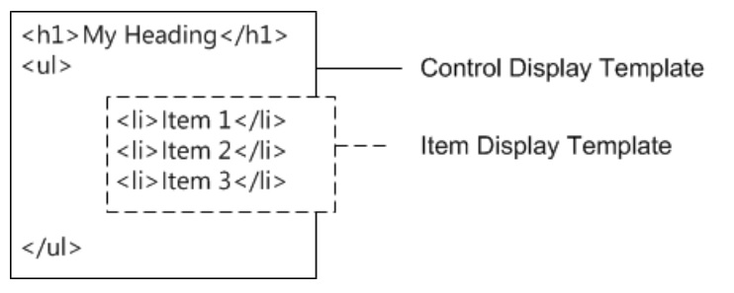
The Logical Model
What a developer needs to understand…
There are basically three main parts and two of these are types of templates:
Web parts – these contain the necessary queries and pointers to templates and fire when search results are available
Control Templates – these define the overall structure of how the results will be displayed, such as pagination, results count, and these templates control the item templates used for individual items
Item Templates – these are applied to individual items and control how these items are rendered. There can be multiple item templates for different types of result items.
Notes:
There are other types of templates as well that can be used for things such as the hover panel display.
The display template consists of an HTML file and an associated .js file. The HTML file is for the developer, the .js file is for SharePoint and is created by SharePoint.
Changes made in the HTML file are automatically reflected in the .js file.
.js is strictly for SharePoint internal use and not to be changed by users.

Slide 11
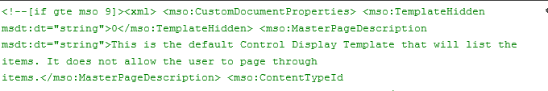
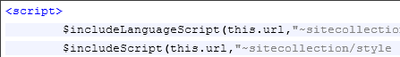
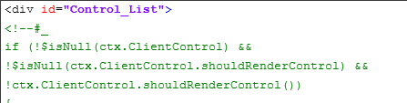
Control Display Template (Structure)
Header Properties
Script Block
Div Block
Notes:
Header Properties- This section has Display Template header properties that provide information to SharePoint about the Display Template
Script Block - This section is used to reference JavaScript and CSS files.
Div Block - Following the <script> tag is a <div> tag with an ID. By default the ID for this <div> tag matches the name of the Display Template file. The HTML or JavaScript you want the display template to render must be included inside this <div> tag. However, the tag itself is not included in the markup that is rendered on the webpage.

Slide 12
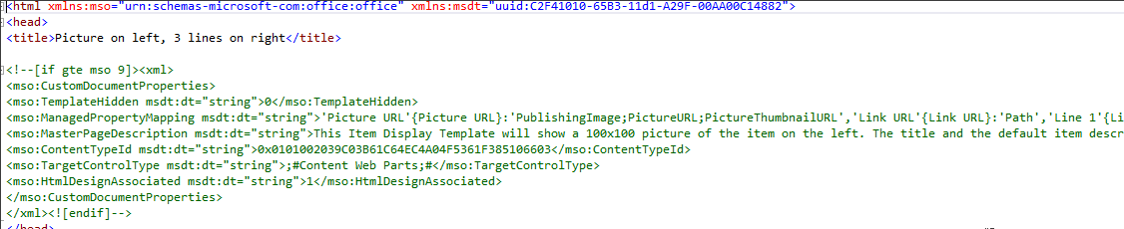
Item Display Template (Structure - Header)
Header Properties
Add managed properties you want to use under the ManagedPropertyMapping header
ManagedPropertyMapping - Maps managed properties to values used by the display templates
Format:
'property display name'{property name}:'managed property'
Notes:
Header Properties-In order to use a Search Managed Property, it should be first added under ManagedPropertyMapping header. To get a list of all Managed Properties that are returned from Search query. In order to see all the properties, you can execute your template, and trace it in something like fiddler. Properties under ResultRows element in the trace are returned by search query in JSON format and can be used in Display Template.
ManagedPropertyMapping - This property takes the managed properties that are used by search and maps them to values that can be used by the display template. The property is a comma-delimited list of values that uses the following format: 'property display name'{property name}:'managed property'. For example, 'Picture URL'{Picture URL}:'PublishingImage;PictureURL;PictureThumbnailURL'.
Same as Control Templates, Item Templates also have Script Blocks and Outer DIVs with matching DIV ID as template name.

Slide 13
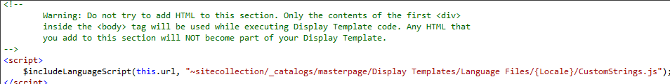
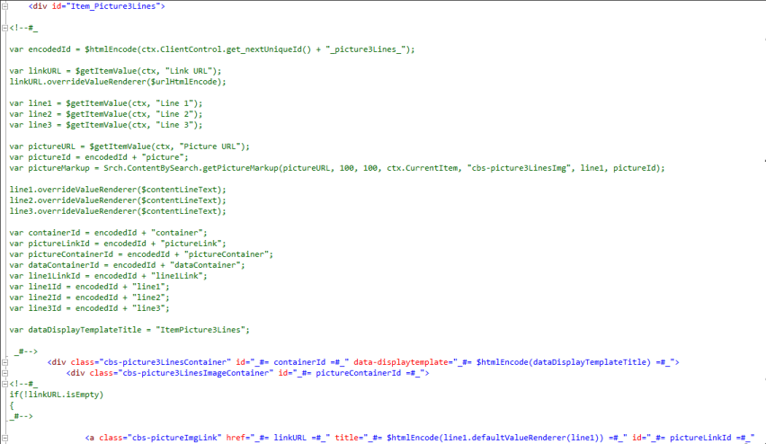
Item Display Template (Script & Div Blocks)
Script Block
Div Block
Notes:
Script Block - This section is used to reference JavaScript and CSS files. Scripting should be put under outer DIV. After you map a property in header, you can get its value in script.

Slide 14
Display Templates & Result Types
Demo
Notes:
Now that we’ve covered some building block basics… let’s take a look at it

Slide 15
Search Based Site Directory

Slide 16
Search based site directory
Demo

Slide 17
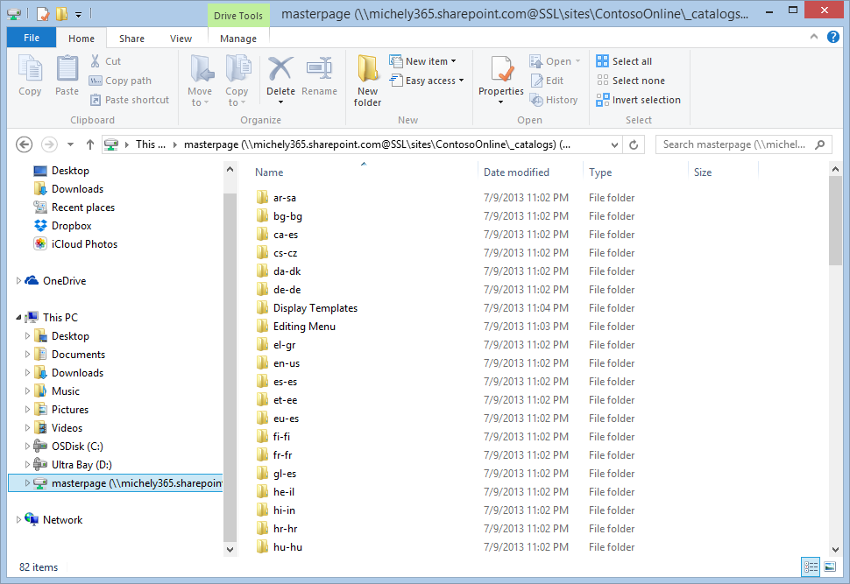
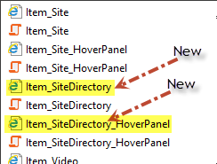
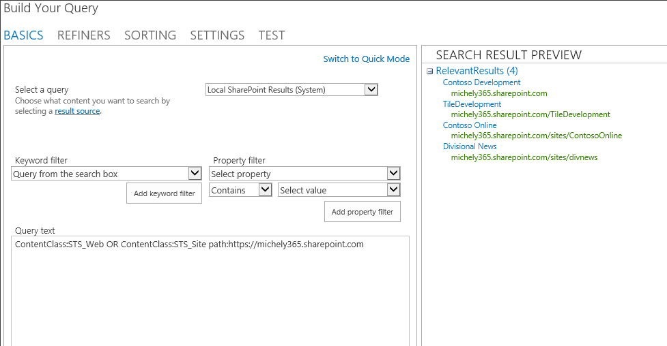
Creating a search based site directory
1
2
3
4
5
HTML
(edit)
Condition
Action
Template
Create Search Results Page
Condition
Action
Template
Condition
Action
Template
.js
(Site Settings -> Search Result Types)
6
7
Web part Properties
Display Templates
Result Types
Results Settings
…
(Query Builder)
ContentClass:STS_Web OR ContentClass:STS_Site path:https://<your site Url>
Notes:
With windows explorer, create and open a mapped network drive to the sites master page gallery. Open the Display Templates folder, then the Search folder. There you will see templates and associated javascript files.
Choose the template(s) closest to what you want to create. In this case, the item_site and item_site_hoverpanel. Copy those and rename accordingly. SharePoint will generate the associated .js files.
Edit your HTML templates to achieve your desired layout and plug in your content placeholders for things such as managed properties. Updates will be synced by SharePoint to the javascript file.
Define your result types and display templates they map to.
Create a new page to host your search based Site Directory. This can be a search results web part page. Edit and remove any unwanted items from the page.
Modify your query options. Set your query text and filtering, refiners, sorting and other settings.
Modify the rest of the web part settings such as Choosing result types, display templates, and other settings
Preview and make adjustments as necessary

Slide 18
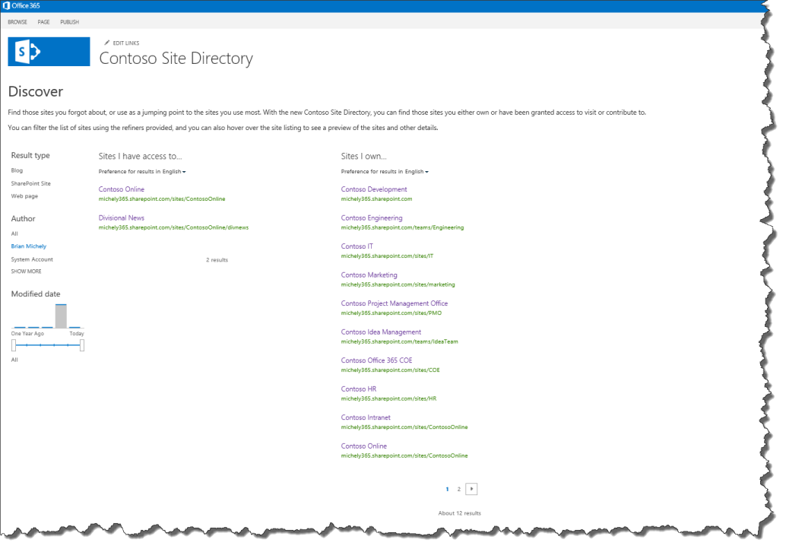
Site Directory Example
Notes:
This screen capture shows an example site directory with two search results web parts and a refinement web part. The “Sites I own” results are configured to show only the sites I am the owner of. While the “Sites I have access to” results are just that… sites I have access to and that results web part is tied to the left side refinement web part. You can pretty much add anything you wan to this page to brand it the way you would like.

Slide 19
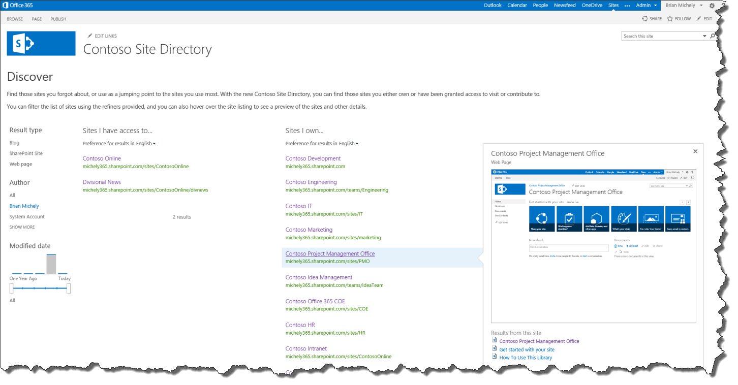
Site Directory Example
Notes:
This particular page shows the usage of the hover panel, which can also be customized.

Slide 20
Using Search API in Apps and Content

Slide 21

Search-Everywhere
Built-in
Search-based functionality is found almost everywhere in SharePoint
Extensibility points
There are also extensibility points for partner built and custom built search based apps and there are many ways to extend:
UI
Query API’s, Syntax and Rules
Metadata and Content
Vertical solutions
Relevance and Linguistics
Notes:
Search based functionality is used all over the place in SharePoint 2013. It’s used in search centers, social features, people search, and in WCM functionality.

Slide 22
Dynamic Content
Behind the scenes
Many ways to use search to drive what content is rendered to users
Featured News apps
Your News apps (News tailored to you, your line of business, etc.)
Products and Services Catalogs
Suggestions and Related Items (driven by search, and search analytics)
Next, we’ll talk about executing queries to get the data for these apps

Slide 23

Executing Queries: Query Languages
Keyword Query Syntax
Preferred method
FAST Query Language
Still available
SQL Query
Removed from the Product
Notes:
In the past there have been three different Query syntax languages we have used with Search.
The Keyword Query Syntax, FAST Query Language and the SQL Query Language.
In this version we are unifying the query language and basically in the version KQL is the preferred Method for query Search.
KQL allows you to do things like take a Managed property and say it equals or contains a value. So a KQL query might look something like Title:”SharePoint” which means return items where the Title managed property contains SharePoint.
KQL contains all the basics and it is a simpler syntax, it is the language used in the user interface and is the preferred method to write queries for the Search in code as well. The Keyword query language has also now been enhanced and contains supports proximity queries like “NEAR”.
The FAST Query language is still in place, but there more for supporting existing implementations. All of the key capabilities in the FAST Query language have been moved to the Keyword Query Language, so it isn’t necessary to continue to leverage FAST Query language going forward.
The SQL Query syntax has been removed from the platform.
The point is that KQL is really the language to use.

Slide 24
Executing Queries: KQL
Searching For… | Keyword | Example | Description
General | Text | Training | Search for items containing “Training”
 | Wildcard | Train* | Search for items like “Training” and “Trainer”
 | Phrase | “Training Room” | Search for the exact phrase
Documents | IsDocument | Training IsDocument:1 | Returns documents containing “Training”
 | FileExtension | Training FileExtension:docx | Returns Word documents containing “Training”
 | Author | Author:Cox IsDocument:1 | Returns documents authored by “Cox”
 | Title | Title:Training IsDocument:1 | Returns documents with “Training” in the title
People | Lastname | Lastname:C | Returns all people whose last name starts with “C”
Tasks | contentClass | contentClass:STS_ListItem_Tasks | Returns all task items
Events | contentClass | contentClass:STS_ListItem_Events | Returns all calendar events
Notes:
This table shows different examples of what we can do with the Keyword Query Language.
For example Searching for Text with wild cards or Phrases.
Returning only Documents in the Results.
Returning documents with specific extensions.
And Matching keywords on specific metadata properties.
We can also see how to search for People (in this case based on their last Name) and how we can query for other specific item types such as Tasks or Events.
A lot of what you know about Keyword query search from 2010 will work in this version, but you will also see it has been extended and things that you were able to do specifically in FAST have now been moved into this version of the Keyword query language.

Slide 25
Executing Queries: REST
Keywords
http://server/site/_api/search/query?querytext='{KQL Query}‘
Selecting Properties
http://server/site/_api/search/query?querytext='test'&selectproperties='Title,Rank'
Sorting
http://server/site/_api/search/query?querytext='test'&sortlist='LastModifiedTime:descending'
http://server/site/_api/search/query?querytext='test'&sortlist='LastModifiedTime:descending,Rank:ascending'
Notes:
As we talked about earlier in the Search overview the Query capability is now exposed as a REST service. So we are able to execute Searches based on URL.
Here we can see the syntax for the URL used to execute the query and how we pass the KQL Query. The example of selecting properties shows how we can execute a query of “Test” and only selecting properties of Title and Rank in the results.
We can specify Sorting in the REST API and you can see where we are sorting by LastModifiedTime and Rank.
Permissions
Scope: http://sharepoint/search
Right: QueryAsUserIgnoreAppPrincipal

Slide 26
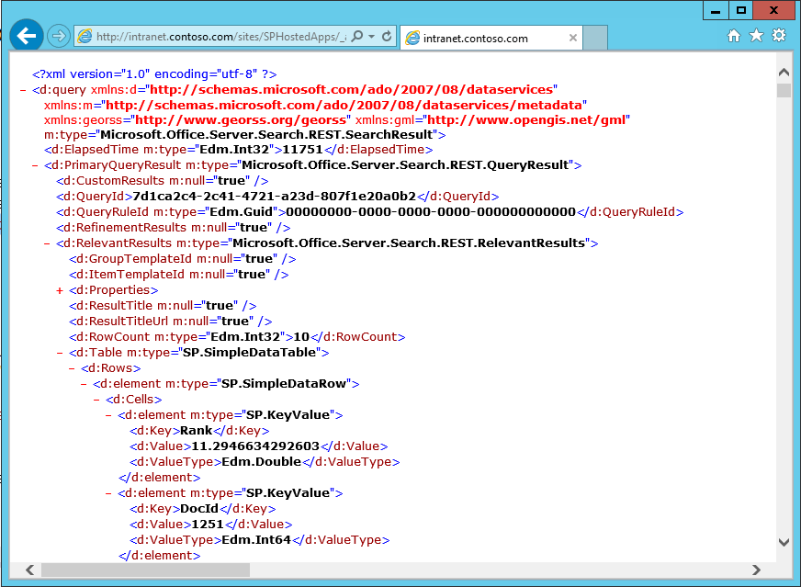
Executing Queries: REST
/_api/search/query?querytext='Argument'
Notes:
Here is an example of calling the REST API with an Argument if you were to execute it from the browser. We would be leveraging a development language to better handle the returned REST results, but being able to see the Schema and data that is returned on a result and showing that a document is returned in a consist fashion is useful.

Slide 27
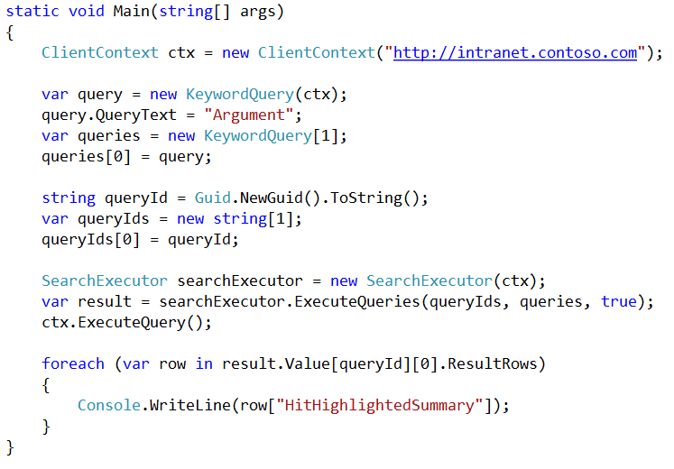
Executing Queries: CSOM
Notes:
Along with the REST API we have Client Object Model Code that can be used to execute queries and parse results.
You can see from this code we are setting up a KeywordQuery and setting the QueryText to an Argument and the QueryID to a new Guid.
Then using a SearchExecutor.ExecuteQueries passing it the Query ID arrays and Query Text Array.
This query is doing the same as what we saw before in the REST query, the method of which you use (REST or CSOM) depends on the context and language you are needing to execute the search.

Slide 28
Executing Queries: Query Throttling
Client Types
Search Center P1
Unspecified P3
Throttling Based on Query Latencies
“System too busy”
OOB Configuration
Enabled for SharePoint Online
Disable for On-Prem
Notes:
Note: OOB in on-prem scenarios query throttling is turned off. In SPO we plan to have it turned on so that tenants cannot impact each other’s query performance.
Client Types are a mechanism for us to throttle incoming queries. We enumerate all of the OOB sources where we issue queries and assign them a Client Type + a priority. E.g., a query from a search center would be P1 (Priority 1 type of Search); a query to refresh the site map might be P3 (priority three – lower priority search). So if the Engine is working hard to answer a lot of queries and there are latencies involved with returning results then there will be a message returned to lower priority clients saying please try your search again later. To give a graceful degradation of results instead of showing a hung query.
This is more of a concern if you are writing apps for SharePoint online, but not necessarily a concern for on Prem as the capabilities is not enabled by default.
But the primary dev scenario: you’ll want to create a new Client Type for your app and pass that in at query time…otherwise we’ll default to P3 and you may get throttled (ie error returned as “system is too busy…try again later”). A very useful tool for segment traffic and degrade “gracefully” in SPO where query loads could be spiky.
OOB every client that issues a query specifies a ClientType and we have added those to the OOB list. Every other app needs to specify this in the Query object that they create so that they can configure which tier they belong to – this happens using this UI. If query latencies in a higher tier are worse than a threshold (configurable on-prem) we start throttling queries from lower tiers (and potentially higher tiers as well) so as to give more processing throughput to the higher tiers.

Slide 29
Search - The Content Side
If it’s not crawled and indexed…
You may not find it
Connectors and Crawlers
SharePoint can access content from almost anywhere
Pre-created connectors
Framework and tools to create custom connectors
Rich set of partner connectors available
Notes:
SharePoint can access content from almost anywhere, not just from within. There are pre-created connectors and a framework exists to extend the ability to create connectors to whatever source you like. There is also a rich set of partner-built connectors to take advantage of as well.

Slide 30
The Connector – How it works
SharePoint
Connector
1 – Connect securely
Email
Search Engine
File Shares
2 – Map content
Web Content
3 – Feed content
4 – Find any changes
Databases
Enterprise Repositories

Slide 31
Using search API in the apps and in content
Demo

Slide 32
Personalized Search Results

Slide 33
Content suggestion
This section is actually more about showing results from search in personalized way… like showing only news which are relevant for particular user based on organization property in user profile
Update – changed the content. May not have better images that are not customer focused… - Brian

Slide 34
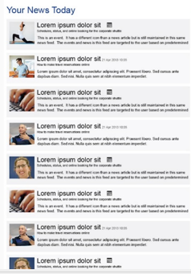
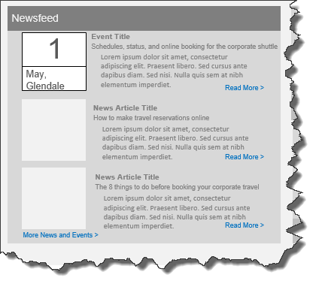
Your News:
Deliver relevant content targeted to your users such as news and events
Notes:
This app could use the out-of-box search results webpart and display templates to display the news information with title, description and rollup image. By default, the app could show the first ten news items. The number of news to be displayed could be configurable through the app properties.
On Click of Image, Title and Read More, will take the user to news article page.
On Click of More News ands Events, the webpart shows the next ten result set of the news information.
Criteria for displaying the news and events Information can be something such as.
Filter the news information based on user profile property Business unit, region and language.
Retrieving the Title, description and rollup image and URL of the news.
The sorting logic for combined news and events could be by LastModifiedDate

Slide 35
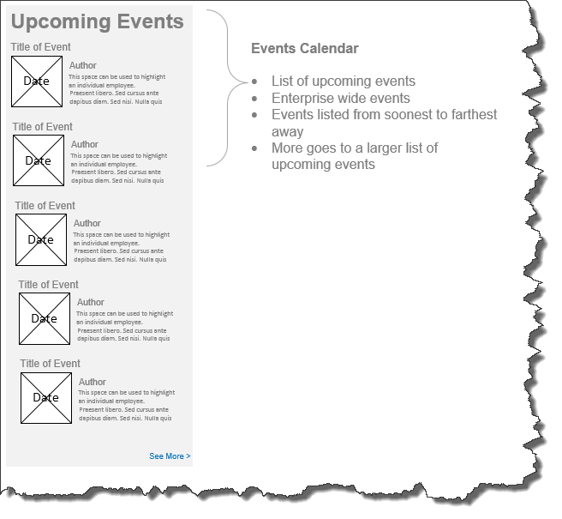
Upcoming Events:
Deliver relevant events targeted to your users using search and display templates
Notes:
This app uses OOB search results webpart to configure the search query to retrieve only the upcoming events information. By default, app shows the latest ten upcoming events information. This can be configurable through the app properties. This app could also use custom display templates to render the events information. On Click of Image, Title and Read More, can take the user to out of the box events information page. On Click of See More, the app could show the next ten results of events.

Slide 36

Featured News:
Deliver search results as featured content targeted to your users in places such as corporate intranet and divisional landing pages
Notes:
This can easily be implemented as a JQuery plugin with HTML and wrapped in an app part pulling content from the search index. Once again, you can target featured news to your users on a divisional portal for example, or choose to target or not to target on an intranet portal.

Slide 37
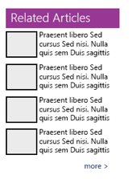
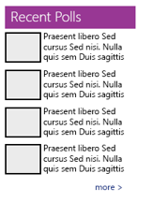
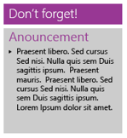

Dynamic:
Using search, metadata, display templates and profile data, there are many possibilities to move away from static content and keep the content targeted, fresh and keep the users engaged.
Here are a few other possibilities…

Slide 38
Personalized search results
Demo

Slide 39
Search Configuration and Customizations

Slide 40
Search Portability
“Search Portability” supports transferring the following items:
Results sources
Query rules
Result types
Schema
Custom ranking models
Can transfer between a tenant, site collection, or site
“Transfer” items by using the Import or Export Configuration
Also available using CSOM

Slide 41
Export and Import Search Settings
CSOM API
Allows targeting export and import of search settings
Handles rules, sources, managed properties, etc
Does not handle master pages, templates, and web parts
Supports migrations, DEV->QA->PROD scenarios
SharePoint UI
Site Settings -> Search -> Configuration Import
Site Settings -> Search -> Configuration Export
Notes:
There are lots of other new enhancements that are designed to improve and manage search. One of those enhancements that we wanted to point out is the ability to export and import Search settings, so in this version of Search we are provided with a CSOM API to export and import Search settings.
This capability is used for things like moving search settings from Dev -> QA to PROD.
In previous versions we had to write a lot of PowerShell scripts to handle some of the recreation of the Managed Properties and Scopes across the different environments. In this version this API should help with these migration scenarios across environments.
While it does handle Rules, Sources and Managed properties, it does not handle Master Pages, Templates or Web Parts.

Slide 42
Import & Export Search Settings
Demo

Slide 43
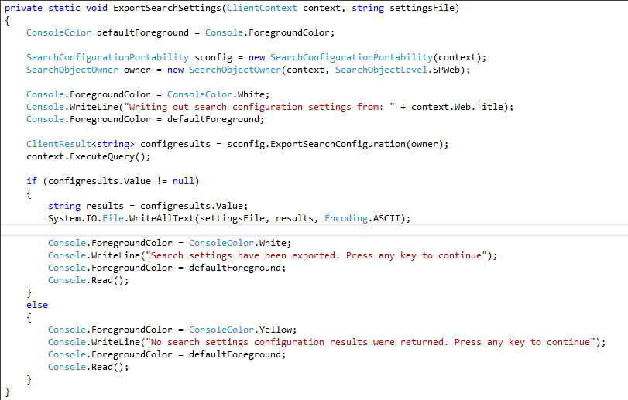
CSOM API - Export

Slide 44
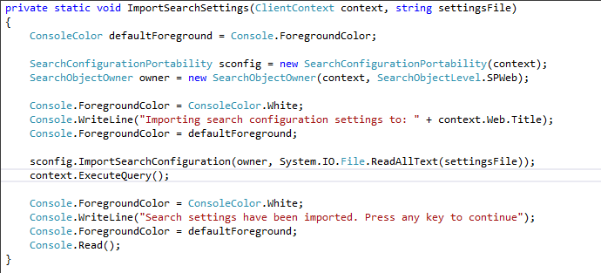
CSOM API - Import

Slide 45
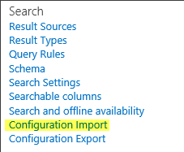
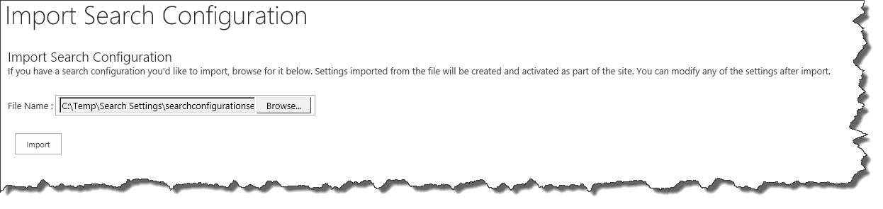
Configuration Import (via UI)

Slide 46

Configuration Export (via UI)
Site Settings -> Search -> Configuration Import
Once clicked, XML file is generated and prompt appears to save the file.

Slide 47
Search configuration and customizations
Demo

Slide 48
Search Center Customizations

Slide 49
Search Center
Results framework - greater control
Rules Engine
Property List
Display Templates
Search web parts - much simpler
Refinement
Search Box
Search Navigation
Search Results

Slide 50
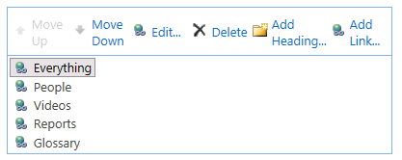
Search Navigation
Utilizes the SPNavigation Provider
Search Center > Site Settings > Search Settings
Notes:
For Search Navigation it uses the SPNavigation provider in 2013.
You can go into the Search Center -> Site Settings -> Search Settings and you will see a common navigation that allows you to add or remove or organize navigation much like you would do on any site navigation.

Slide 51
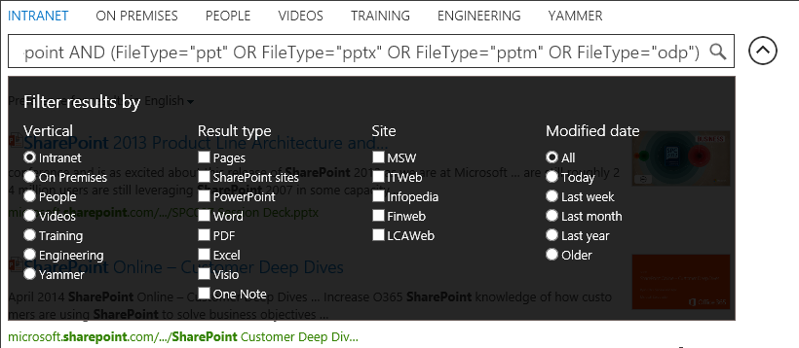
Refiners
Notes:
There are other options for displaying refiners, such as using a drop down pane that displays filtering options….

Slide 52
Search center customizations
Demo

Slide 53
Crawling property bag values

Slide 54
Crawling property bag values from sites
What
Crawl property bag values as site metadata
Why
Build dynamic pages or results based on the metadata stored on the site or list property bag
How
User server side code or enable property bag crawling for site or lists using CSOM by using specific property bag value structure

Slide 55
How to assign properties to be crawled
Client side object model
List<string> keys = new List<string>();
keys.Add(“ProjectCodeId”);
keys.Add(“ProjectPhase”);
StringBuilder stringBuilder = new StringBuilder();
foreach (string current in keys)
{ stringBuilder.Append(Convert.ToBase64String(Encoding.Unicode.GetBytes(current)));
stringBuilder.Append('|');
}
value = stringBuilder.ToString();
var props = clientContext.Web.AllProperties;
clientContext.Load(props);
clientContext.ExecuteQuery();
props[“vti_indexedpropertykeys”] = value;
clientContext.Web.Update();
clientContext.ExecuteQuery();
Server side object model
web = Get-SPWeb http://localhost $web.AllProperties["Prop1"] = "value1" $web.IndexedPropertyKeys.Add("Prop1") $web.Update()
Next, here's how you add an indexable property to a list:
$list = $web.Lists["Announcements"] $folder = $list.RootFolder $folder.Properties["Prop2"] = "Spammers" $folder.Update() $list.IndexedRootFolderPropertyKeys.Add("Prop2") $list.Update()
Notes:
Web service call out allows you to modify managed property values or add new properties
Example: You can add additional information like a rating from a web service that’s not part of the metadata information normally.
Content Pipeline is the one place where you have access to all of the searched items before the index gets created.
Data Cleansing: You can use this to normalize data like making «MSFT» or «Microsoft» into «Microsoft Corporation» by changing the value of a managed property
Entity Extraction: Allows for adding managed properties to a document that didn’t exist before based on values in the body of the document
Classification and Tagging: Allows for adding managed properties to a document that didn’t exist before based on classification rules (for example this looks like a quarterly report, so we may add addtional managed properties on it for quarterly reports).
The web service client is configured with:
SOAP RPC endpoint
- Implements a well-defined interface
Optional SSL transport security
Trigger condition: checks existence/values of managed properties before doing call-out (allows for rules that determine when the callout happens)
We don’t want the websevice called for all items going through the pipeline.
Input managed properties: set of managed properties to send to web service, includes read-only managed properties
Output managed properties: set of managed properties returned from web service, can not include read-only properties
Failure mode: if web service generates error, either log warning and index document OR fail document and return error code to crawler
There are size limits for each property returned from the web service + a total size for the message.

Slide 56


© 2014 Microsoft Corporation. All rights reserved. Microsoft, Windows, and other product names are or may be registered trademarks and/or trademarks in the U.S. and/or other countries.
The information herein is for informational purposes only and represents the current view of Microsoft Corporation as of the date of this presentation. Because Microsoft must respond to changing market conditions, it should not be interpreted to be a commitment on the part of Microsoft, and Microsoft cannot guarantee the accuracy of any information provided after the date of this presentation. MICROSOFT MAKES NO WARRANTIES, EXPRESS, IMPLIED OR STATUTORY, AS TO THE INFORMATION IN THIS PRESENTATION.

